Slide 1

Chapter 12
Multiple Access
12.<number>
Copyright © The McGraw-Hill Companies, Inc. Permission required for reproduction or display.

Slide 2

Figure 12.1 Data link layer divided into two functionality-oriented sublayers
12.<number>

Slide 3

Figure 12.2 Taxonomy of multiple-access protocols discussed in this chapter
12.<number>

Slide 4
Binary Exponential Backoff
Sender sends immediately with idle channel
Continues to listen while transmitting
In case of a collision, the sender waits for a random period (maximum of two time slots)
In case they collide again, the interval is just doubled every time it experiences a collision
When doubling is repeated to the slot size to 0–1023 it will not increase further

Slide 5
Binary Exponential Back off Algorithm
Time is divided into discrete slots whose length is equal to the worst-case round-trip propagation time on the either (2τ).
    minimum frame is 64 bytes (header + 46 bytes of data) = 512 bits
    Channel capacity 10 Mbps, 512/10 M = 51.2µ
After 1st collision, each station waits for 0 or 1 time slot before trying again.
After 2nd collision, each station picks up either 0,1,2 or 3 at random and waits for that much time slots.
If 3rd collision occurs, then next time number of slots to wait is chosen randomly from interval 0 to 2³-1.
In general, after i^{th} collision, random number between 0 to 2^{i} -1 is chosen, that number of time slot is skipped.
After 10th collision, randomized interval is frozen at max of 1023 slots.
After 16th collision, controller reports failure back to computer sending and further recovery is upto higher layers.
This algorithm is called Binary Exponential Back off Algorithm.
Advantage: Ensures a low delay when only a few stations collide, but also assures that the collision is resolved in a reasonable interval when many stations collide.
Disadvantage: Could introduce significant delay.

Slide 6
12-1 RANDOM ACCESS
In random access or contention methods, no station is superior to another station and none is assigned the control over another. No station permits, or does not permit, another station to send. At each instance, a station that has data to send uses a procedure defined by the protocol to make a decision on whether or not to send.
Topics discussed in this section:
ALOHA
Carrier Sense Multiple Access
Carrier Sense Multiple Access with Collision Detection
Carrier Sense Multiple Access with Collision Avoidance
12.<number>

Slide 7
ALOHA
Norman Abramson at University of Hawaii, in 70’s wanted to connect computer centers of all the islands of Hawaii.
Hawaii is a collection of islands and it was not possible to connect them with telephone lines.
Joining islands with wires laid on seabed was very expensive, so they started thinking about wireless solution.
Solution: ALOHA
  Using short range radios.
  Half duplex by nature. At a time, only can send or receiver. Switching also takes time.
  Two different frequencies, one for sending, another for receiving.
  But, problem of collision, how to solve it?
  Solution: Let the users communicate, if signals collide, not acknowledged and so, sender resends data.
  Adding randomness reduces the chance of collision.
  Algorithm is called Binary Exponential Back-off Algorithm.
  Also had problem: While transmitting, sender can not sense collision.
  In ALOHA, maximum 18 out of 100 packets pass without collision if ALOHA works with optimum speed.

Slide 8
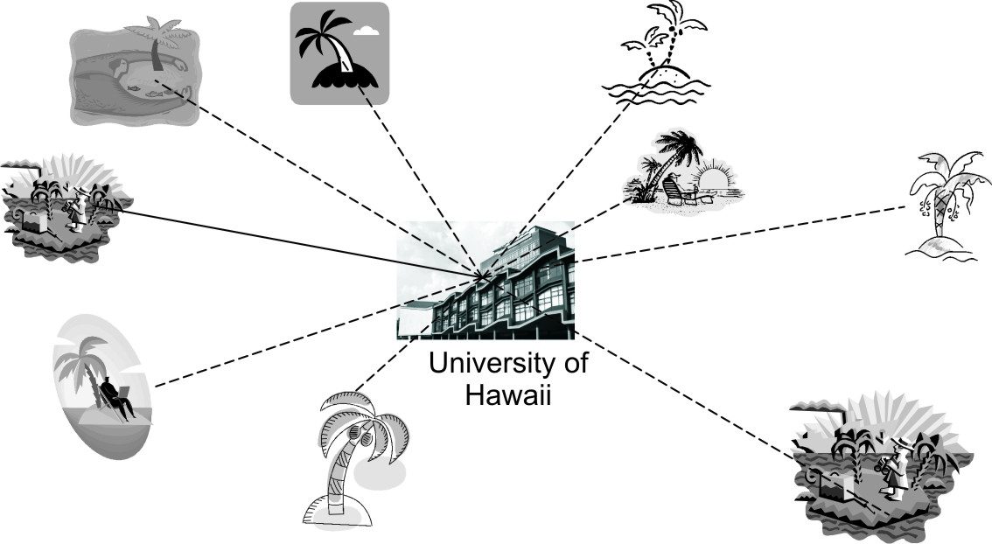
ALOHA connecting islands at Hawaii

Slide 9
Slotted ALOHA
Solution: Slotted ALOHA
  Robert, in 1972 proposed a scheme.
  Packets are vulnerable to collide with only those packets which were transmitted before, but not during the lifetime.
  He divided timeslots equal to lifetime of packets.
  Packet can be transmitted only in beginning of next slot only.
  Slotted ALOHA introduces additional delay.
  Eg : B is to be transmitted during A’s lifetime, B will be delayed till next slot.
  Thus, reducing collision probability to half and performance is doubled.
  In slotted ALOHA, 36 out of 100 packets are delivered without collision at optimum speed.
  In slotted ALOHA time is divided into discrete intervals, each corresponding to one frame.
  A computer is not permitted to send whenever it has data to send.
  Instead it is required to wait for the next available slot.
Well, it still needs improvement.
See next figures that explain ALOHA and Slotted ALOHA.

Slide 10

Figure 12.3 Frames in a pure ALOHA network
12.<number>

Slide 11

Figure 12.4 Procedure for pure ALOHA protocol
12.<number>

Slide 12

Figure 12.5 Vulnerable time for pure ALOHA protocol
12.<number>

Slide 13

Figure 12.6 Frames in a slotted ALOHA network
12.<number>

Slide 14

Figure 12.7 Vulnerable time for slotted ALOHA protocol
12.<number>

Slide 15

Figure 12.8 Space/time model of the collision in CSMA
12.<number>

Slide 16

Figure 12.9 Vulnerable time in CSMA
12.<number>

Slide 17

Figure 12.10 Behavior of three persistence methods
12.<number>

Slide 18

Figure 12.11 Flow diagram for three persistence methods
12.<number>

Slide 19
CSMA:
TYPES:
1. 1 Persistent CSMA
2. Non Persistent CSMA
3. P Persistent CSMA
4. CSMA/CD

Slide 20
Carrier Sense Multiple Access (CSMA)
Protocols in which stations listen for a carrier (i.e. transmission) and act accordingly are called carrier sense protocols.
1-persistent CSMA
Channel Busy ➔ Continue sensing until free and then grab.
Channel Idle ➔ Transmit with probability 1.
Collision ➔ Wait for a random length of time and try again.
Non-persistent CSMA:
Channel Busy ➔ Does not continually sense the channel. Wait for a random length of time and try again.
Channel Idle ➔ Transmit.
Collision ➔ Wait for a random length of time and try again.
Notes:
Prof. Bhargavi H Goswami, Email:bhargavigoswami@gmail.com, Mob: +91 7383816996

Slide 21
P-persistent CSMA:
Channel Busy ➔ Continue sensing until free (same as idle).
Channel Idle ➔ Transmit with probability p, and defer transmitting until the next slot with probability q = 1-p.
Collision ➔ Wait for a random length of time and try again.
Analysis:
  The non-persistent CSMA has better channel utilization but longer delays than 1-persistent CSMA.
  CSMA are an improvement over ALOHA because they ensure that no station begins to transmit when it senses the channel busy.
  Another improvement is for stations to abort their transmissions as soon as they detect a collision.
  Quickly terminating damaged frames saves time and bandwidth.
  This protocol is called CSMA/CD (CSMA with Collision Detection).
By: Dr. Bhargavi H. Goswami, 9426669020, Email:bhargavigoswami@gmail.com
Notes:
Prof. Bhargavi H Goswami, Email:bhargavigoswami@gmail.com, Mob: +91 7383816996

Slide 22
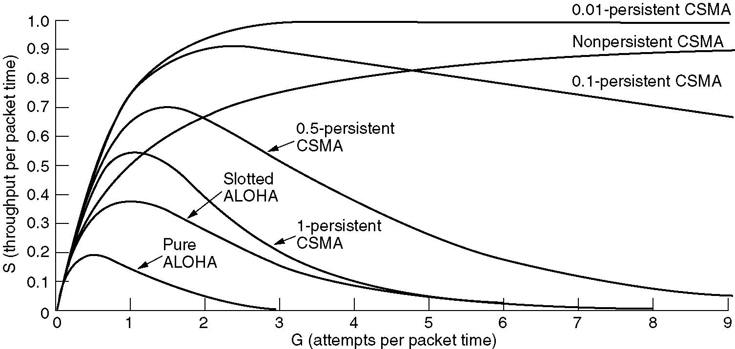
Persistent and Nonpersistent CSMA
Comparison of the channel utilization versus load for various random access protocols.

Slide 23
CSMA/CD
Carrier Sense: Ethernet card listen to channel before transmission and differ to transmit if somebody else is already transmitting.
Multiple Access: More than one user needs channel access.
Collision Detection: Protocol listen when transmission is going on and find stop transmitting when it finds colliding.
Interframe gap: As soon as channel becomes free, it waits for small interframe gap and then transmits. Interframe gap is idle time between frames. After a frame has been sent, transmitters are required to transmit a minimum of 96 bits (12 octets) of idle line state before transmitting the next frame.
Maximum distance limitation: Frame size min 64 bytes.
Minimum frame size limitation: Frame length min 250 m.
Both, distance and size can not be increased together.
More bandwidth deteriorates performance.
If first 64 bytes are successfully received, means later there would be no collision.

Slide 24
Collision Detection & Avoidance
Collision garble the frames.
Collision Detection:
  Let collision happen and then solve it.
  If sender detects collision, it can stop sending and restart later by following ‘binary back-off algorithm’.
  Need a mechanism to listen to channel.
  Used by classic Ethernet.
Collision Avoidance:
  See that collision do not occur by carefully avoiding it.
  Here, it is possible to extract any component signal from collided signal. So retransmission is not needed. We just extract what we need from the received signals.
  Preferred by 802.11 wireless LANs.
  CDMA Code Division Multiple Access is used in Mobile phones.

Slide 25
CSMA/CA
Collision Avoidance with Career Sense Multiple Access.
On Wireless Networks
Strategies:
  1. Inter-frame Spacing (IFS)
  2. Contention Window – Binary Exponential Back off Algorithm
  3. Acknowledgement

Slide 26
Wireless LAN Protocol
Because signal strength is not uniform throughout the space in which wireless LANs operate, carrier detection and collision may fail in the following ways:
  Hidden nodes:
    Hidden stations: Carrier sensing may fail to detect another station. For example, A and D.
    Fading: The strength of radio signals diminished rapidly with the distance from the transmitter. For example, A and C.
  Exposed nodes:
    Exposed stations: B is sending to A. C can detect it. C might want to send to E but conclude it cannot transmit because C hears B.
    Collision masking: The local signal might drown out the remote transmission.
The result scheme is carrier sensing multiple access with collision avoidance (CSMA/CA).

Slide 27
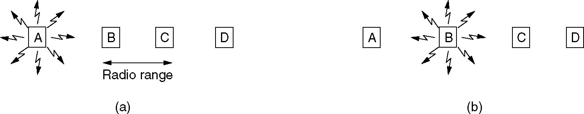
Wireless LAN Protocols
Hidden station problem: A is transmitting to B. C cannot hear A. If C starts transmitting, it will interfere at B.
Exposed station problem: B is transmitting to A. C concludes that it may not send to D but the interference exists only between B and C.
A wireless LAN.
(a) A transmitting. (b) B transmitting.

Slide 28
MACA and MACAW
MACA: Multiple Access with Collision Avoidance:
The sender transmits a RTS (Request To Send) frame.
The receiver replies with a CTS (Clear To Send) frame.
Neighbors
  see CTS, then keep quiet.
  see RTS but not CTS, then keep quiet until the CTS is back to the sender.
The receiver sends an ACK when receiving an frame.
  Neighbors keep silent until see ACK.
Collisions
  There is no collision detection.
  The senders know collision when they don’t receive CTS.
  They each wait for the exponential backoff time.
MACAW (MACA for Wireless) is a revision of MACA which introduced ACK mechanism.
Till ACK are seen, other stations remain silent.

Slide 29
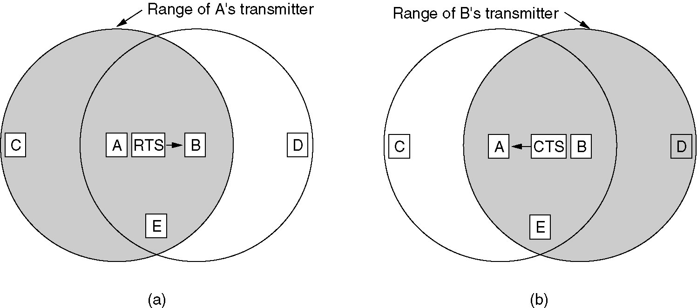
Wireless LAN Protocols (2)
The MACA protocol.
(a) A sending an RTS to B.
(b) B responding with a CTS to A.
By: Dr. Bhargavi H. Goswami, 9426669020, Email:bhargavigoswami@gmail.com

Slide 30
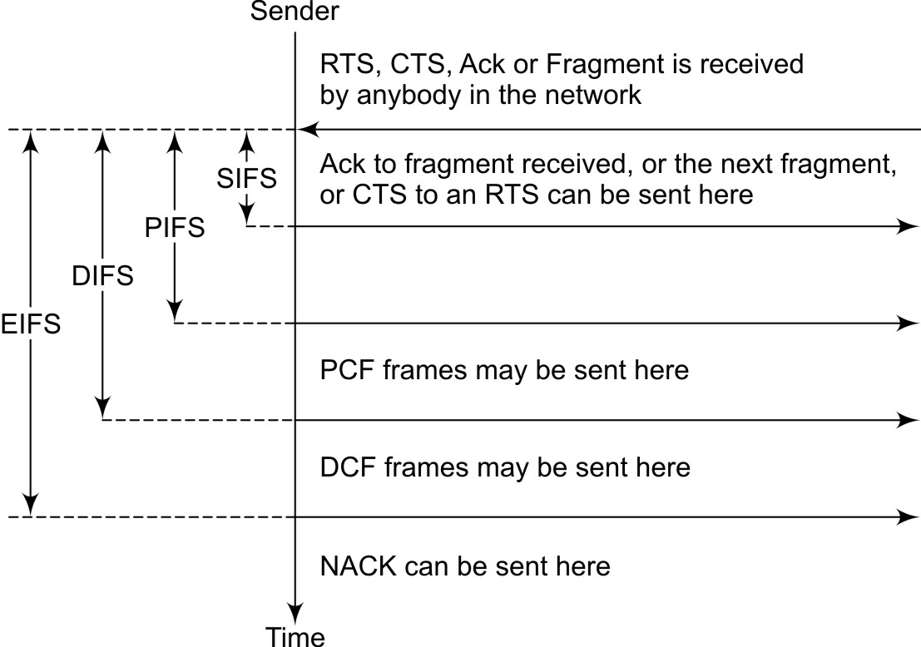
Different Inter-frame spacing

Slide 31

Figure 12.12 Collision of the first bit in CSMA/CD
12.<number>

Slide 32

Figure 12.13 Collision and abortion in CSMA/CD
12.<number>

Slide 33

Figure 12.14 Flow diagram for the CSMA/CD
12.<number>

Slide 34

Figure 12.15 Energy level during transmission, idleness, or collision
12.<number>

Slide 35

Figure 12.16 Timing in CSMA/CA
12.<number>

Slide 36

Note
In CSMA/CA, the IFS can also be used to define the priority of a station or a frame.
12.<number>

Slide 37
Note
In CSMA/CA, if the station finds the channel busy, it does not restart the timer of the contention window;
it stops the timer and restarts it when the channel becomes idle.
12.<number>

Slide 38

Figure 12.17 Flow diagram for CSMA/CA
12.<number>

Slide 39
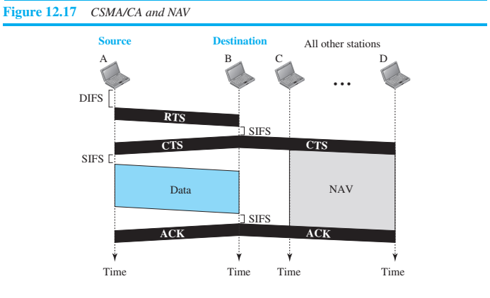
NAV – DIFS – SIFS – PIFS – EIFS – CTS - RTS
network allocation vector (NAV) that shows how much time must pass before
these stations are allowed to check the channel for idleness.
12.<number>

Slide 40
12-2 CONTROLLED ACCESS
In controlled access, the stations consult one another to find which station has the right to send. A station cannot send unless it has been authorized by other stations. We discuss three popular controlled-access methods.
Topics discussed in this section:
Reservation
Polling
Token Passing
12.<number>

Slide 41

Figure 12.18 Reservation access method
12.<number>

Slide 42

Figure 12.19 Select and poll functions in polling access method
12.<number>

Slide 43

Figure 12.20 Logical ring and physical topology in token-passing access method
12.<number>

Slide 44
12-3 CHANNELIZATION
Channelization is a multiple-access method in which the available bandwidth of a link is shared in time, frequency, or through code, between different stations. In this section, we discuss three channelization protocols.
Topics discussed in this section:
Frequency-Division Multiple Access (FDMA)
Time-Division Multiple Access (TDMA)
Code-Division Multiple Access (CDMA)
12.<number>

Slide 45
Note
We see the application of all these methods in Chapter 16 when
we discuss cellular phone systems.
12.<number>

Slide 46

Figure 12.21 Frequency-division multiple access (FDMA)
12.<number>

Slide 47
Note
In FDMA, the available bandwidth
of the common channel is divided into bands that are separated by guard bands.
12.<number>

Slide 48

Figure 12.22 Time-division multiple access (TDMA)
12.<number>

Slide 49
Note
In TDMA, the bandwidth is just one channel that is timeshared between different stations.
12.<number>

Slide 50
Note
In CDMA, one channel carries all transmissions simultaneously.
12.<number>

Slide 51

Figure 12.23 Simple idea of communication with code
12.<number>

Slide 52
Figure 12.24 Chip sequences
12.<number>

Slide 53
Figure 12.25 Data representation in CDMA
12.<number>

Slide 54

Figure 12.26 Sharing channel in CDMA
12.<number>

Slide 55

Figure 12.27 Digital signal created by four stations in CDMA
12.<number>

Slide 56

Figure 12.28 Decoding of the composite signal for one in CDMA
12.<number>

